Slide 1
DSIF Group 2
Project 1 Presentation
10 July 2021

Slide 2
Problem Statement
To present recommendations to the US Department of Education on how they should focus their effort & resources to improve overall SAT and ACT participation rates and scores. This is based on studying:
Different States
Races
College Majors
Income Background
School Subsidies

Slide 3
External Data Sources Used
US map geometry: US Census Bureau Cartography Data 2018
State policy on administering / offering SAT and ACT: PrepScholar
Fee waiver / school subsidies: Collegeboard & ACT.org
College data:The Condition of College & Career Readiness 2019 for ACT
Races: Collegeboard
Segmentation of states into multiple region: US Census Bureau 2010
Median Household Income :
https://www.census.gov/topics/income-poverty.html
https://worldpopulationreview.com/state-rankings/average-income-by-state
https://www.census.gov/library/visualizations/interactive/2019-median-household-income.html

Slide 4
Methodologies
Assumptions
Data Gathering & Cleaning
Exploratory Data Analysis & Statistical Analysis
Visualization & Recommendation
Data analysis is focused on 51 US states: 50 US states + 1 federal state (“District of Columbia”). The 5 inhabited US territories are excluded
Supporting data is studied in conjunction with SAT , ACT data in year 2019.
“Participation rates” in the SAT and ACT file refer to the % over all of the students who are eligible to take the exam for that year in that state

Slide 5
Recommendations
What?
Where?
Target Result
01
Support state-level effort towards administering tests to students
Iowa, Kansas and South Dakota
To increase combined (SAT & ACT) test participation from <80% to 100%
What?
Where?
Target Result
02
Provide financial aid to household aiming to take ACT
Mississippi , Arkansas , Louisiana , Alabama, Kentucky , Oklahoma
To increase their ACT mean score towards the 25% by 2021
What?
Where?
Target Result
03
Fee waiver and state grant
Iowa , Kansas
To increase their SAT Participation from <5% to min. 30%

Slide 6
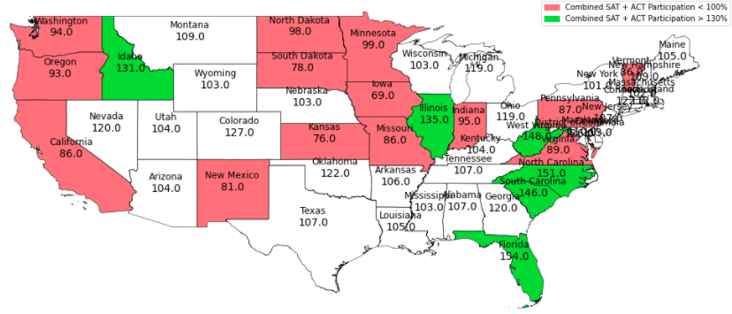
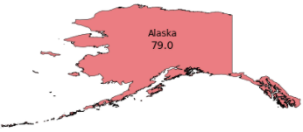

US States with Combined SAT + ACT Participations < 100%
In 2019, states in pink are states have < 100% combined test participations. When sorted, the bottom 3 are Iowa (69%), Kansas (76%) and South Dakota (78%).
These states can be area of focus for state participation improvement
2 states (Hawaii and Alaska) aren’t displayed correctly in this picture, for readability purposes

Slide 7
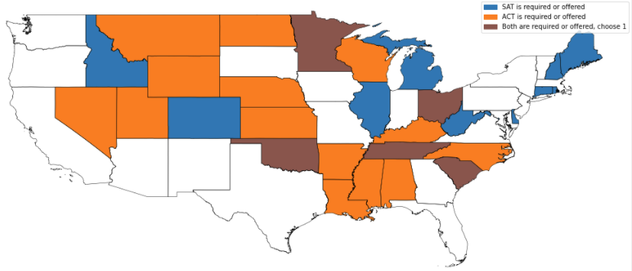
US States with “State-Administered” Policy
Some states have policy where they will administer (requiring students to undertake) / offer SAT and ACT test. This test is usually free and covered-for in the first attempt
Compared to the previous slide, this policy seems to be effective in ensuring students’ participation in SAT / ACT
2 states (Hawaii and Alaska) aren’t displayed in this picture, for readability purposes

Slide 8
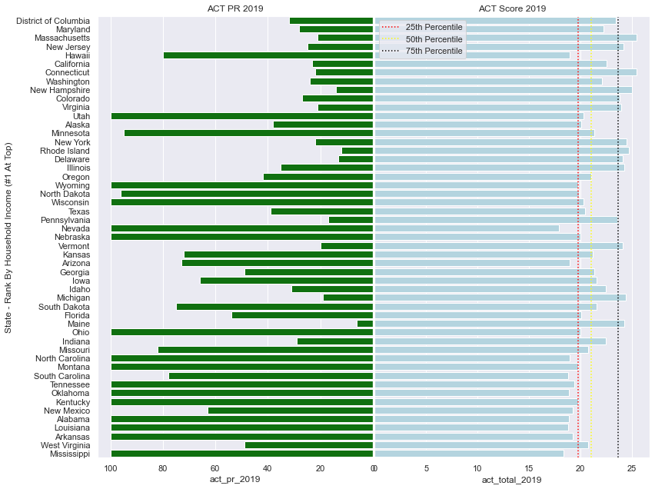
Key Insight for HouseHold Income
Why aid for ACT for Mississippi , Arkansas , Louisiana , Alabama, Kentucky , Oklahoma?
They have lowest household median income
High Participation Rate but low score
*Ranked from Wealthiest from the top

Slide 9
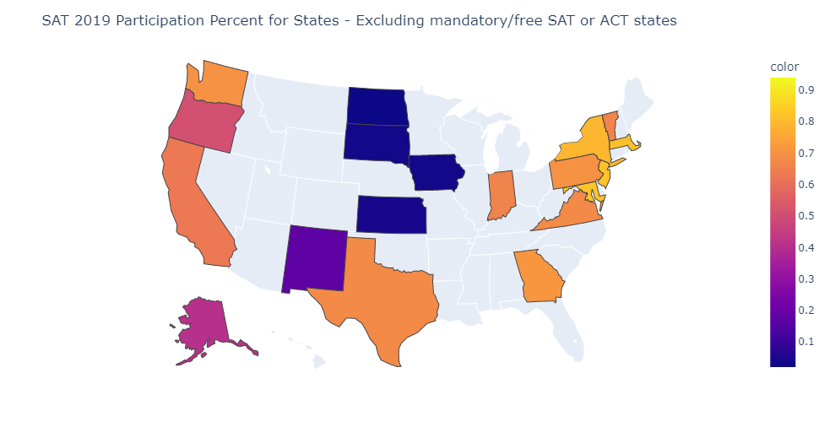
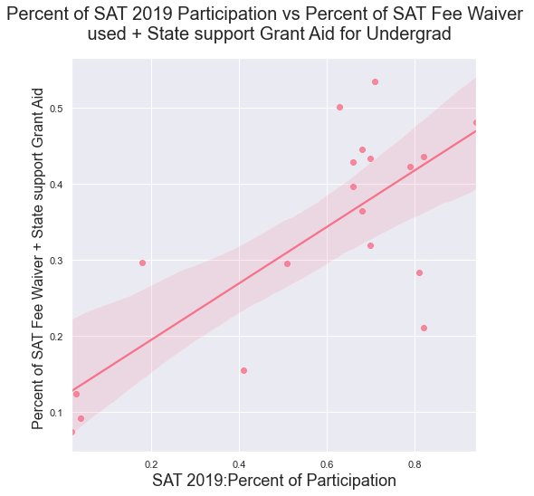
Key Insight for Financial Grants
Participation percent
R square: 0.76
Analysed the states that have less than 100% participation for ACT/SAT
IOWA
SAT Participation percent shows Good correlation to SAT Fee Waiver used+State support Grant Aid for Undergrad
Recommend to focus on Fee waiver/Grant Aid support for low participating states IOWA & KANSAS
KANSAS

Slide 10
Recommendations
What?
Where?
Target Result
01
Support state-level effort towards administering tests to students
Iowa, Kansas and South Dakota
To increase combined (SAT & ACT) test participation from <80% to 100%
What?
Where?
Target Result
02
Provide financial aid to household aiming to take ACT
Mississippi , Arkansas , Louisiana , Alabama, Kentucky , Oklahoma
To increase their ACT mean score towards the 25% by 2021
What?
Where?
Target Result
03
Fee waiver and state grant
Iowa , Kansas
To increase their SAT Participation from <5% to min. 30%

Slide 11
Question & Answer
Session

Slide 12
Appendix

Slide 13
Appendix A - Additional Slides For States Study

Slide 14
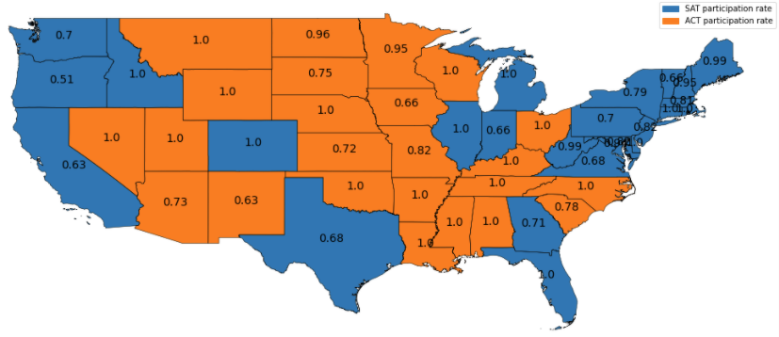
US States & Their More Popular Test
In 2019, there are 8 states with 100% SAT participations and 15 states with 100% ACT participations
There is roughly an equal distribution of states where ACT or SAT is the more dominant test. However, where SAT is more dominant, their number doesn’t quite hit close to 100% participation
2 states (Hawaii and Alaska) aren’t displayed in this picture, for readability purposes

Slide 15
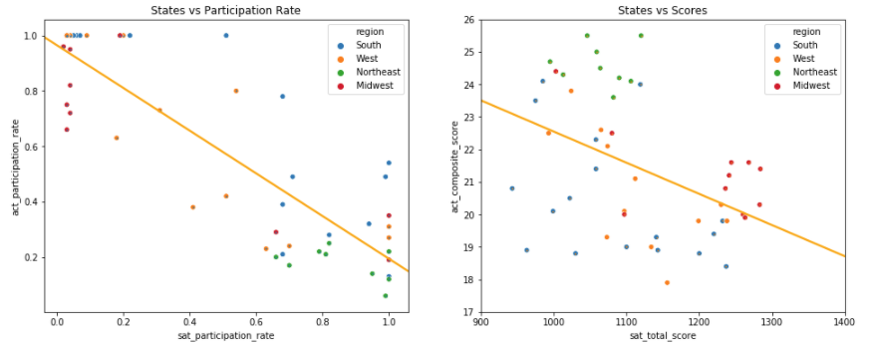
Inverse Correlation of Participation Rates and Scores
There is an inverse correlation between ACT and SAT participation rate, i.e. states cluster around the top-left and bottom-right corners
There is an inverse correlation between participation rate and scores of the same test, e.g. Midwest states who have high ACT participation rate scores much mid-low range of ACT (in bottom-right of the second graph)

Slide 16
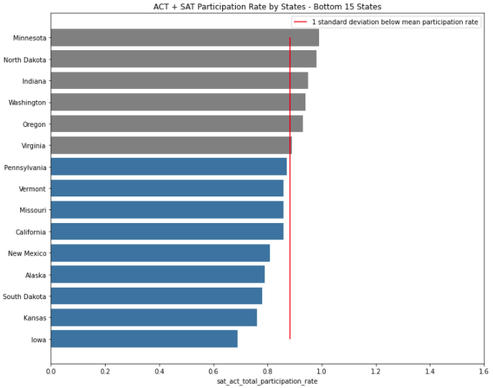
SAT + ACT Combined Participation Rates - Bottom 15 States
Each of the 9 states in blue have a combined SAT + ACT participation rates < 1 standard deviation below the average SAT + ACT combined participation rates.
What this means is that these states are lagging behind in terms of test participations

Slide 17
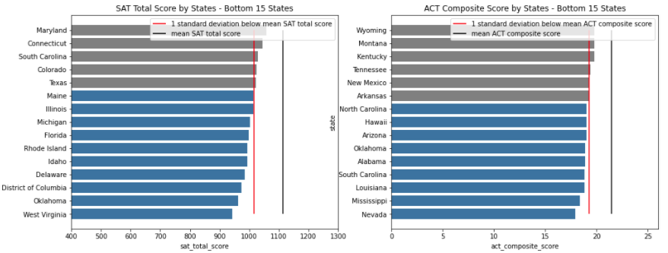
SAT Total Score / ACT Composite Score - Bottom 15 States
The state ‘Oklahoma’ is lagging behind the other states in terms of both ACT and SAT scores.

Slide 18
Appendix B - Additional Slides for Household Income, Poverty Rate and Gini Coeff

Slide 19
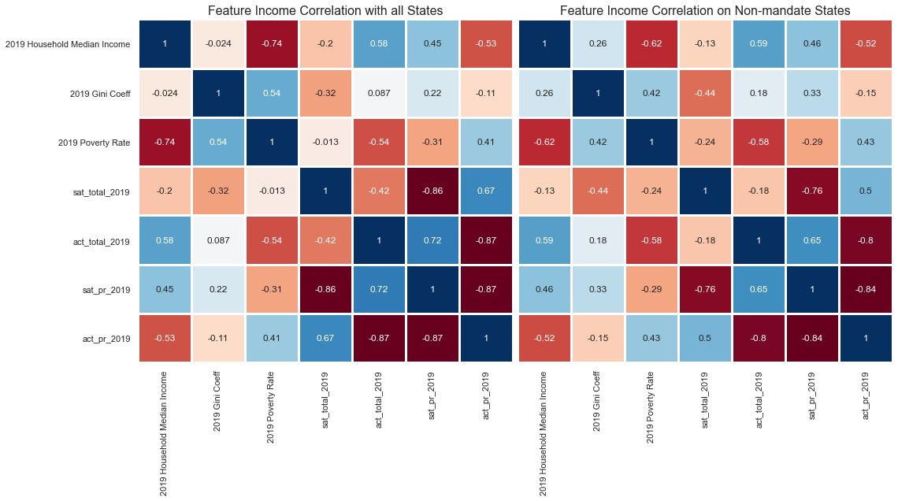
Income features - Correlation Study
All 51 States (Including Mandatory)
29 States (Excluding Mandatory)
Key Insights:
Poverty Rate & Household Income have Strong impact on ACT Score ~0.6 but not SAT
Poverty Rate and Household income have relatively strong correlation with each other, therefore we will just take 1 of these 2 to further study

Slide 20
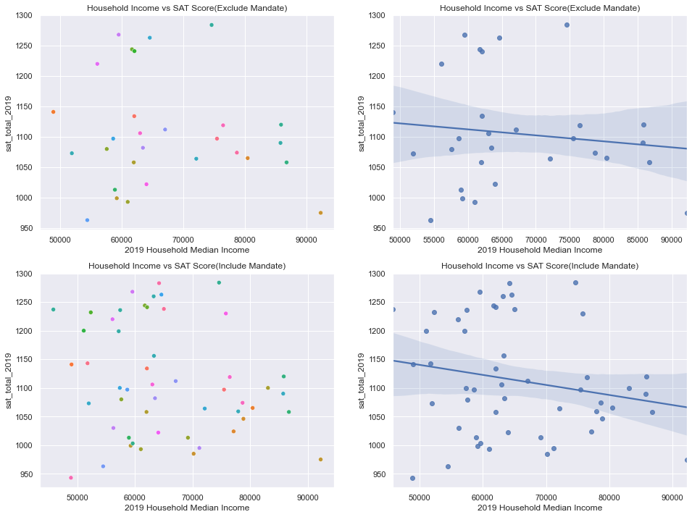
SAT Score 2019
29 States (Excluding Mandatory)
All 51 States (Including Mandatory)
Key Insights:
Lower Income Perform better in SAT
Household Income does not impact SAT Score

Slide 21
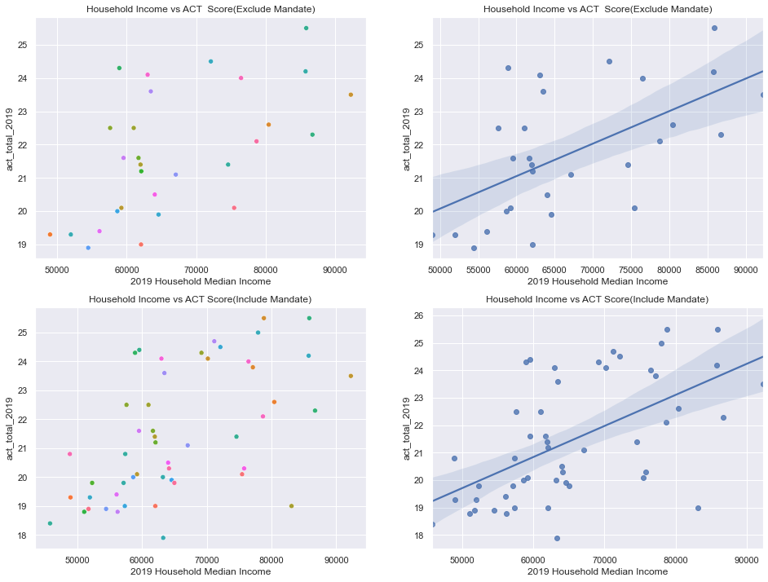
ACT Score 2019
29 States (Excluding Mandatory)
All 51 States (Including Mandatory)
Key Insights:
Lower Income perform not so well in ACT

Slide 22
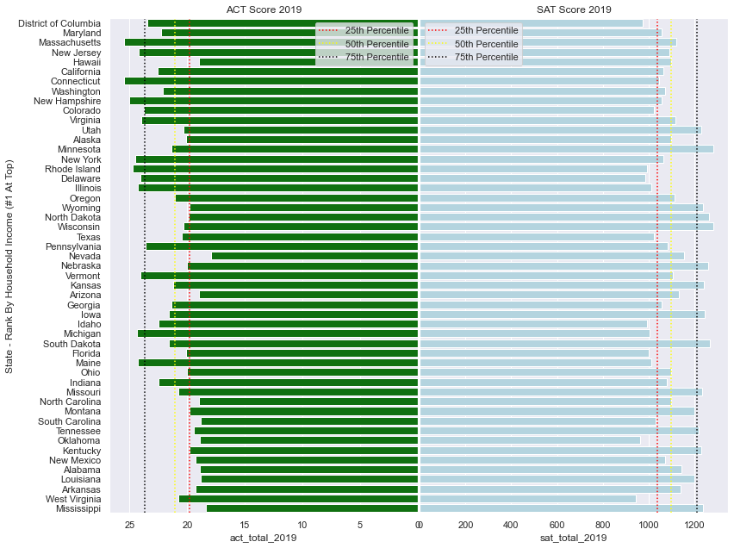
ACT vs SAT Score 2019 - All State
Key Insights:
Lower Income perform not so well in ACT.
Consider all State , based on the bottom 12 median income state, only 1 of 12 state score above the 25% for ACT while 9/12 state score above the 25% percentile for SAT.

Slide 23
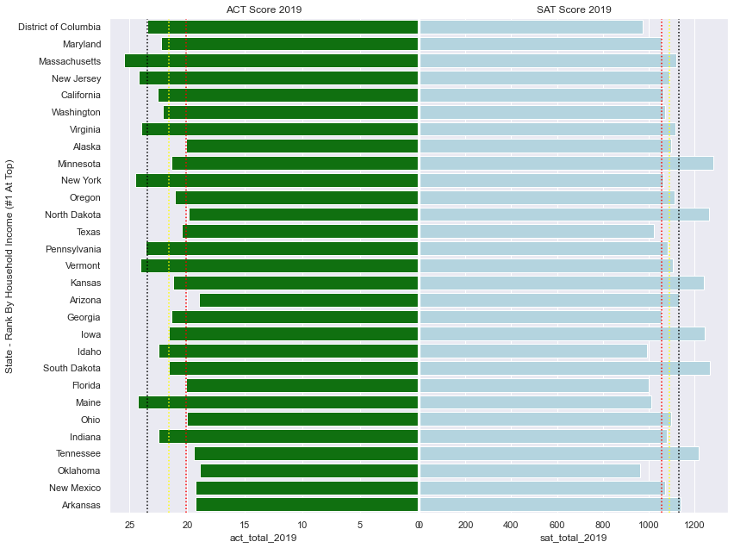
ACT vs SAT Score 2019 - Non -mandatory State
Key Insights:
Lower Income perform not so well in ACT
Consider only non-mandatory state , based on the bottom 5 median income state, only 1/5 state score above the 25% for ACT while 4/5 state score above the 25% percentile for SAT.

Slide 24
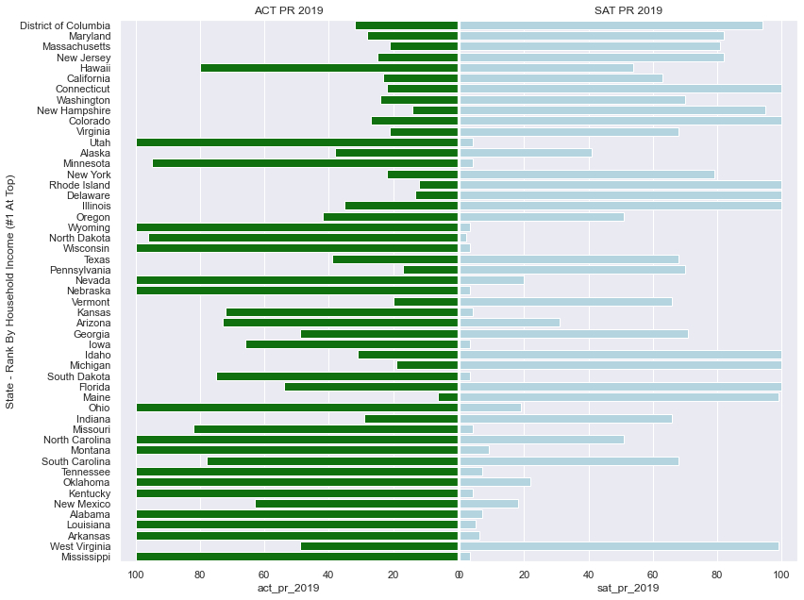
ACT vs SAT Participation Rate
Key Insights:
State with lower median income generally take ACT

Slide 25
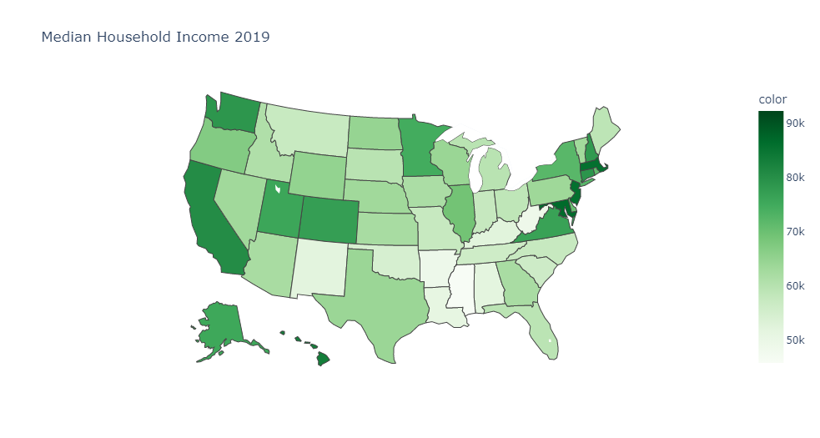
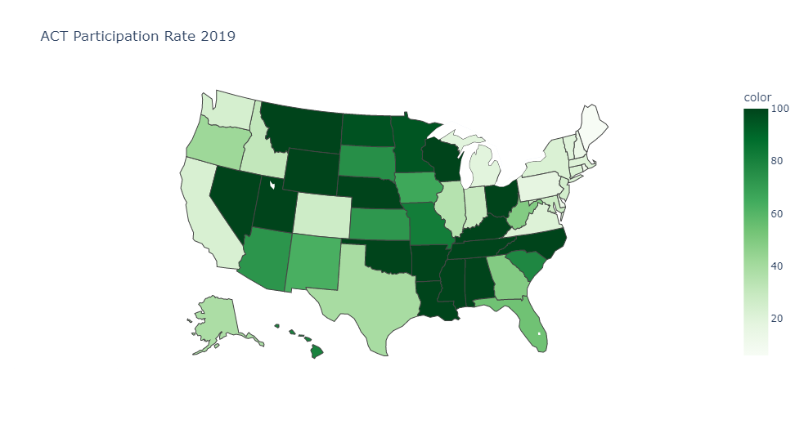
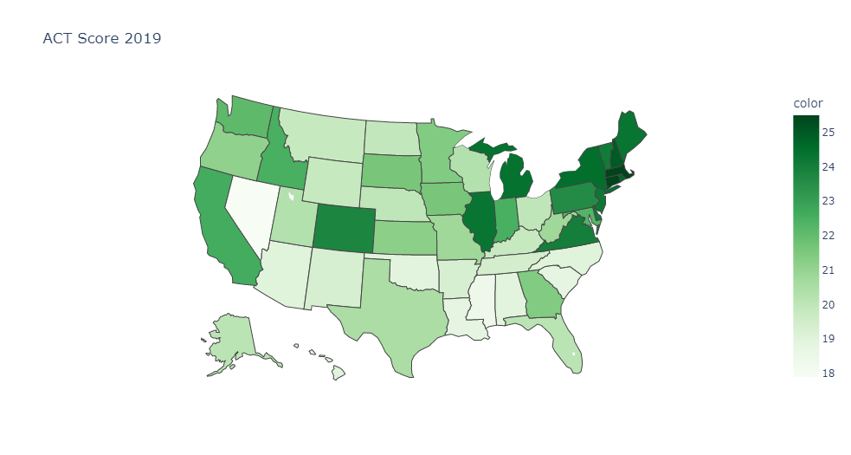
ACT Score vs ACT Participation Rate

Slide 26
Appendix C - Additional Slides for Financial Grant

Slide 27
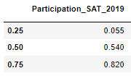
Financial Grants
Percentile
R square: 0.76
Analysed the states that have less than 100% participation for ACT/SAT
SAT Participation percent shows Good correlation to SAT Fee Waiver percent + State support Grant Aid percent for Undergrad

Slide 28

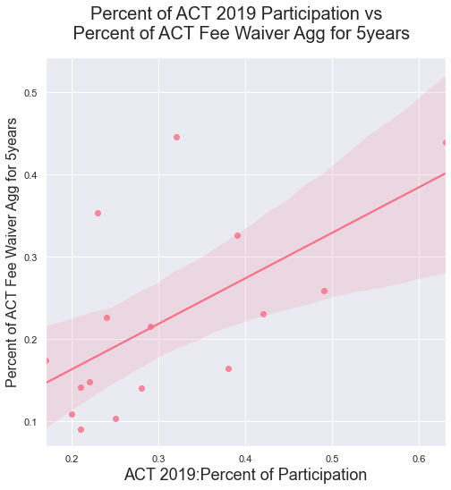
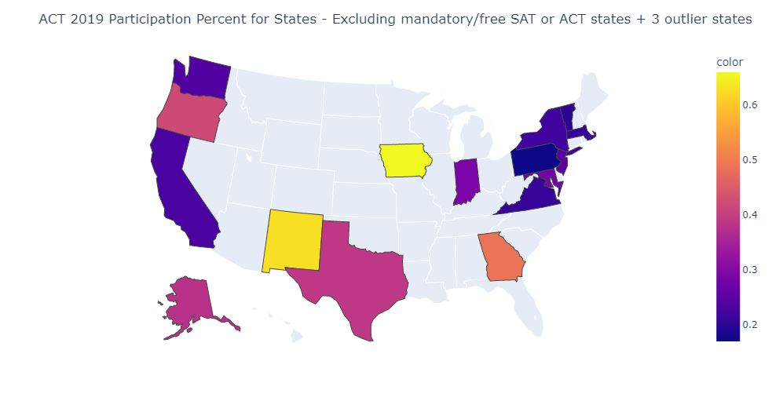
Financial Grants
Participation_ACT_2019
Percentile
R square: 0.61
Analysed the states that have less than 100% participation for ACT/SAT excluding outlier states Kansas, Northdakota, Southdakota
ACT Participation percent shows Good correlation to ACT Fee Waiver percent

Slide 29
Appendix D - Additional Slides for College Major

Slide 30
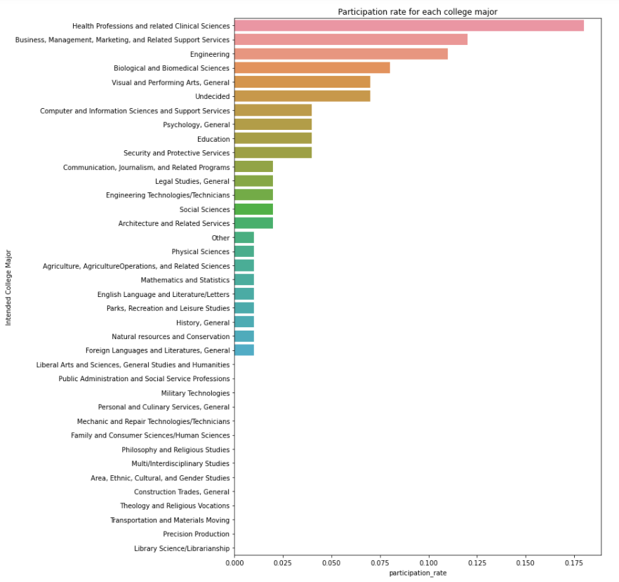
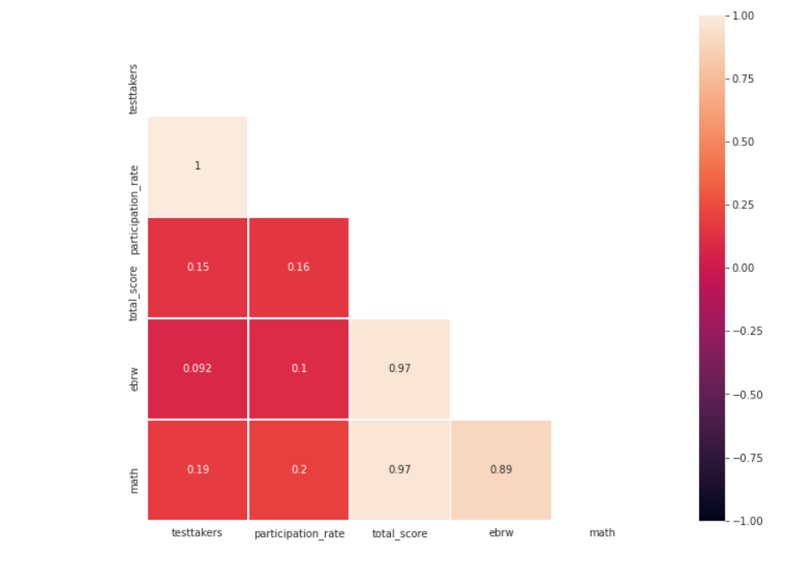
SAT participation by College Majors
Key Insights
Students who are Undecided ranked 6th in SAT.
Health Professions, Business, Engineering ranked top 3

Slide 31
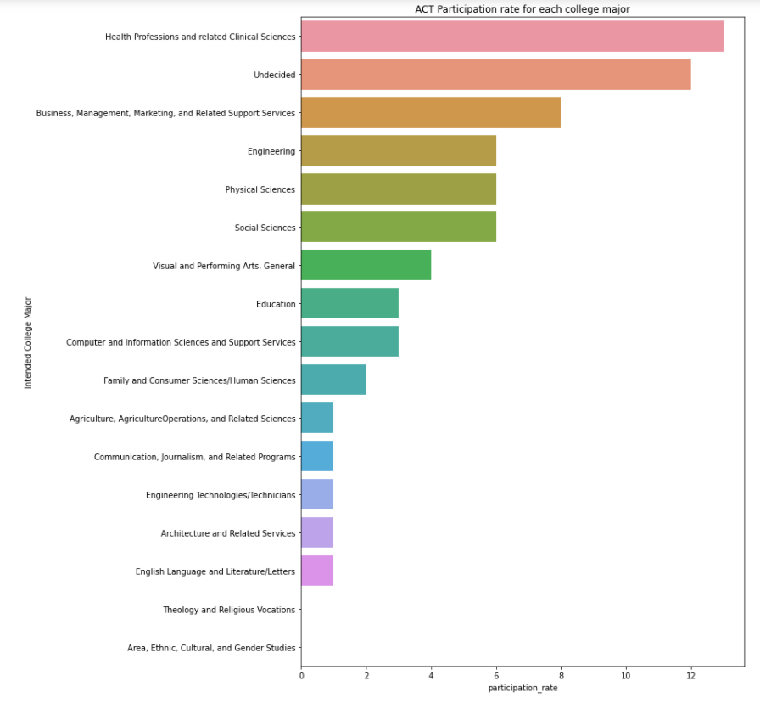
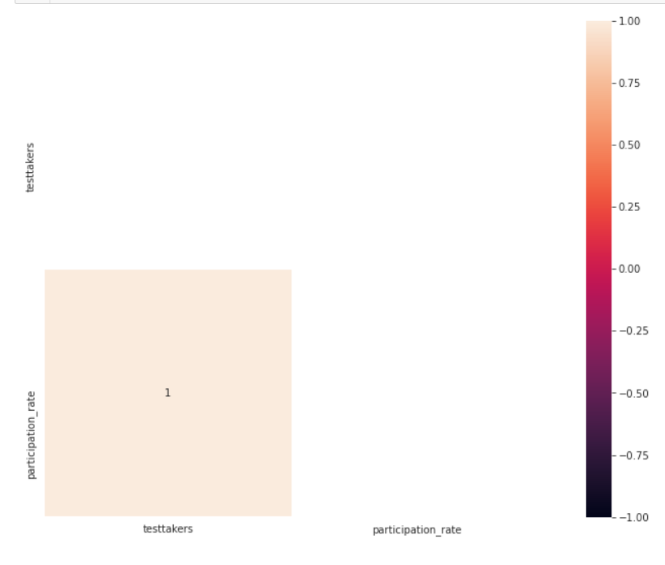
ACT Participation By Intended College Major
Key Insights
Students who are Undecided ranked 2nd for ACT
-Health Professions, Business and Engineering ranked top few based of ACT Participation by Intended College Major

Slide 32
Recommendations based on college major
To provide necessary support to students prior to taking the SAT/ACT test so that they are able to realise areas or fields that they are interested in or that they are excellent at

Slide 33
Appendix E - Additional Slides for Races

Slide 34
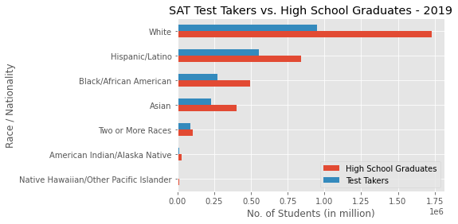
Timothy (Race)

Slide 35
